Slide 1

Deep Learning Approaches to Stock Return Prediction
A Multimodal Framework for Short-Horizon Forecasting
Presenter: Yanming Jing
Supervisors: Dr. Enrico Barbierato | Dr. Alessandro Sbuelz
Academic Year 2024/25

Slide 2
Presentation Roadmap
Introduction
Background
Related Works
Models and experiments
Conclusions
Motivation & Research Questions
Stylized Facts & Limits
literature
Architectures & Experiments
Results & Future Work

Slide 3

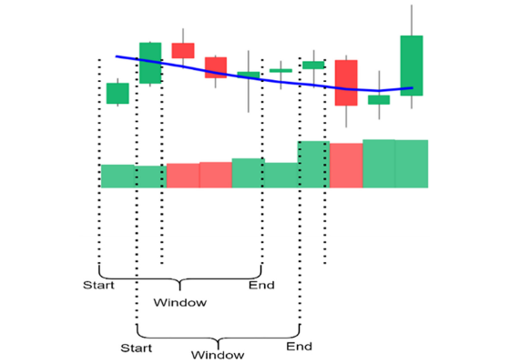
Problem & Motivation
•
Noisy Dynamics: Short-horizon stock returns are extremely non-stationary and stochastic.
•
Illusion of Improvement: In such settings, deep models can appear strong due to overfitting or unstable patterns that don’t generalize out of sample.
•
Leakage Risk: Even small time misalignment in features/labels or preprocessing can create look-ahead bias and inflate results.
•
Solution: Build a leakage-safe, time-consistent, and fully auditable pipeline, and evaluate not only ranking but also reliability.

Slide 4




Research Question & Contributions
Central Question
Main Contributions
In short-term stock-return direction forecasting, does adding count-based news-sentiment and attention indicators produce statistically meaningful improvements over a price-only benchmark under strict time-consistent protocols?
•
Multimodal framework grounded in financial stylized facts.
•
Interpretable count-based news indicators.
•
Leakage-safe preprocessing and chronological splits.
•
Evaluation of both discrimination (ROC) and calibration.

Slide 5
Stylized Facts & Classical Limits
Fact 02
Fact 01
Temporal Dependencies
Non-Linear Dynamics
Deep sequence models like LSTM can represent complex dependencies in market micro-dynamics better than shallow models.
ARIMA/GARCH capture linear mean/variance but struggle with structural breaks and regime shifts.

Slide 6




Multimodal Fusion & Evaluation
Fusion Logic
Metrics
Price features capture endogenous dynamics.
News indicators capture exogenous shocks and attention.
Fusion can be Early / Mid / Late (where information is combined).
Discrimination: ROC-AUC, AP.
Threshold metrics: Accuracy / Precision / Recall / F1.
Reliability: calibration curves.
Sanity checks: predicted positive rate (collapse detection).

Slide 7
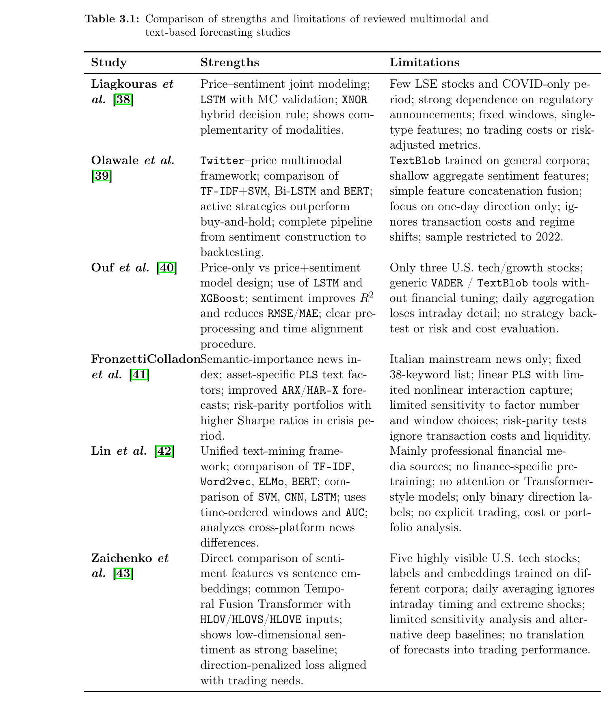
Literature Comparison

Slide 8
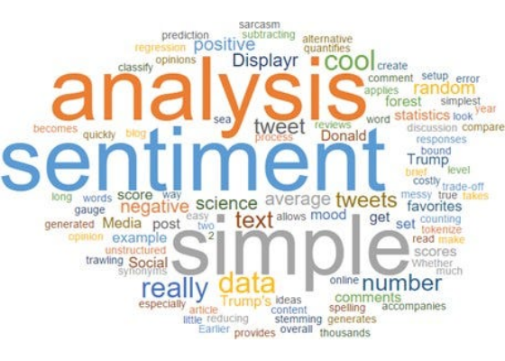
Strategic Takeaways (Liagkouras 2025)
Simple signals can help, but only when:
•
Close to our setting: price indicators and simple text-derived signals
•
Emphasizes interpretable text features (word-frequency style) and robust validation
•
Highlights that fusion benefits depend on careful alignment and evaluation
•
Motivates our count-based news sentiment/attention features under strict splits

Slide 9
Models and Experiments
Isolating the incremental value of news indicators vs. price-only models under strict chronological evaluation.

Slide 10

Data & Universe
•
Universe: 5 Blue-chip A-shares (Core Industries).
•
Period: Jan 2014 – Dec 2023 (Daily frequency).
10,000+
•
Sources:
CSMAR: Market indicators & technicals.
Total Firm-Day Aligned Observations
○
○
CNRDS: Financial news itemization.
•
Task: 1-day ahead return direction (Binary).

Slide 11




Feature System: Structured Data
Market micro-dynamics (daily panel):
Momentum
Volatility
Trend
Pressure
ROC, VA6DR, UMF, PRM, ChangeRatio
ATR, Boll_Upper, Boll_Lower, Boll_Pos, HighPrice–LowPrice
5DAMA, 20DAMA, MACD, MACD_Signal, MACD_Hist, RSI
PWHLD, DPA, IPM, OR, STCPC
Captures
Captures
Captures
Captures
trend inertia & short-term momentum
dynamic risk boundaries & volatility level
trend-following & overbought/oversold
long–short asymmetry, opening shocks & micro-level posture
Note: exact indicator list comes from the thesis feature system section.

Slide 12


Feature System: News Indicators
Raw counts (firm-day)
•
Positive, Neutral, Negative news items
Count-based Proxies
Rationale
•
Sentiment Balance (SB):
Simple, interpretable proxies for tone and attention while keeping the pipeline leakage-resistant.
•
Attention (ATT): News Number counts.
•
Smoothing: Log(1 + ATT).
•
HAS = 1[ATT > 0]

Slide 13

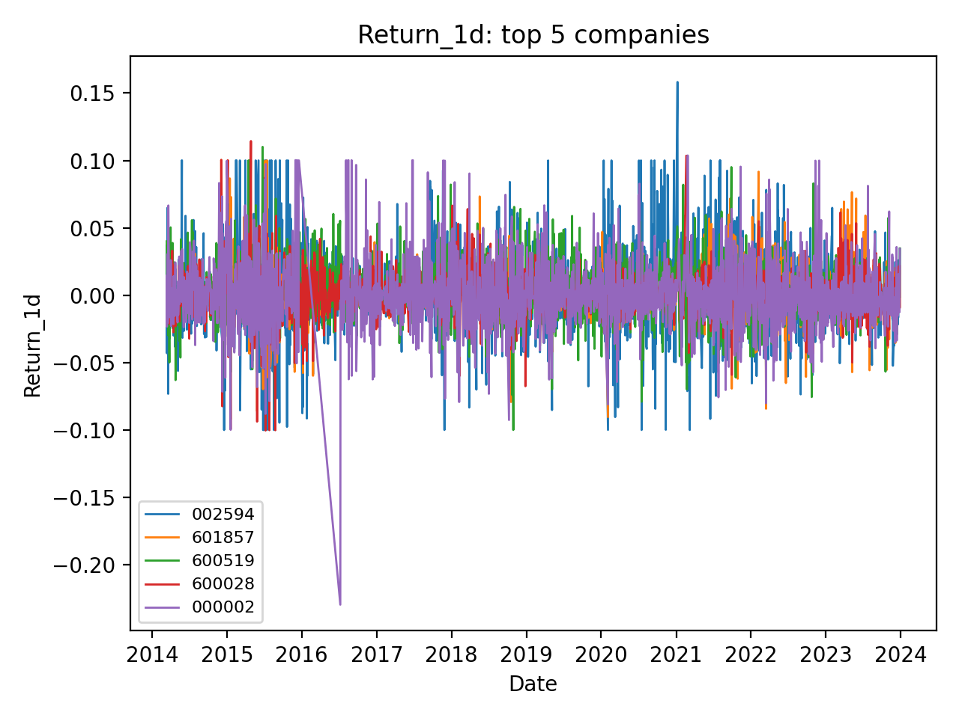

Descriptive: Return Paths
Regime changes and volatility clustering observed across the 2014-2023 period.

Slide 14



Leakage-Safe Preprocessing
Handling Missingness
Robust Scaling
Information Integrity
Add missingness indicators (missing itself can be informative).
Forward-fill continuous features within each stock/time window.
Treat missing news counts as zero (no event day).
Use train-only robust statistics (median) for remaining gaps.
Winsorize extreme values (quantile clipping).
Standardize using train-set parameters only.
Apply identical preprocessing to all models for fair comparison.
No future info used in imputation or outlier detection.

Slide 15
Out-of-Sample Setup
Leakage prevention: each sample is valid only if both
(1) observation date
(2) label date
fall within the same split window.
Subset | Sample Size (N) | Time Period
Training | 8,170 | 2014-03-11 ~ 2020-12-30
Validation | 2,420 | 2021-01-04 ~ 2022-12-29
Test | 1,200 | 2023-01-03 ~ 2023-12-27
Protocol: Each sample is valid only if both observation and label dates fall within the split window.

Slide 16
Traditional ML Baselines (Test)
Model | Split | Accuracy | Precision | Recall | F1 | AUC | AP
Logistic Reg. | Val | 0.549 | 0.505 | 0.423 | 0.460 | 0.546 | 0.486
Random Forest | Val | 0.499 | 0.471 | 0.811 | 0.596 | 0.532 | 0.475
Hist. GBoost | Val | 0.512 | 0.474 | 0.660 | 0.552 | 0.534 | 0.479
Logistic Reg. | Test | 0.531 | 0.457 | 0.431 | 0.444 | 0.510 | 0.442
Random Forest | Test | 0.452 | 0.434 | 0.863 | 0.577 | 0.506 | 0.436
Hist. GBoost | Test | 0.465 | 0.425 | 0.660 | 0.517 | 0.500 | 0.441
Interpretation: Traditional models converge near-random (0.50 AUC) under regime shifts.

Slide 17
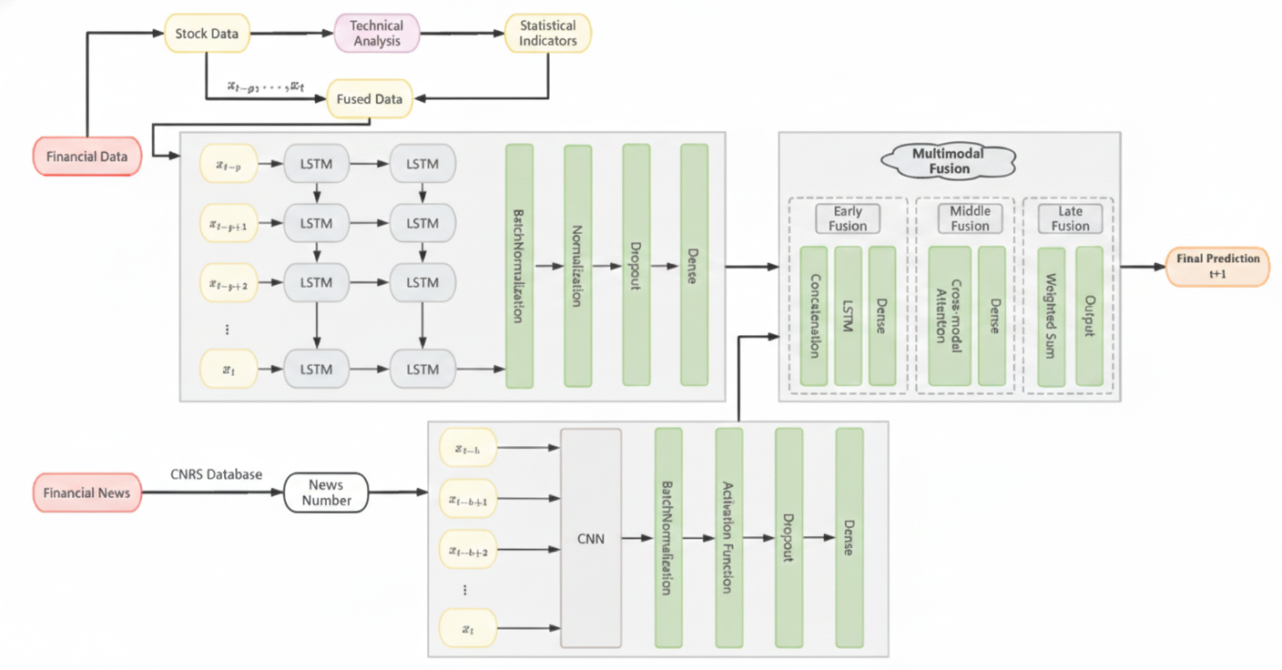
Multimodal Architecture
•
Price Branch: 1-layer LSTM (T=5).
•
News Branch: 1D-CNN (News Number).
•
Fusion: Early / Late / Mid strategies tested.

Slide 18
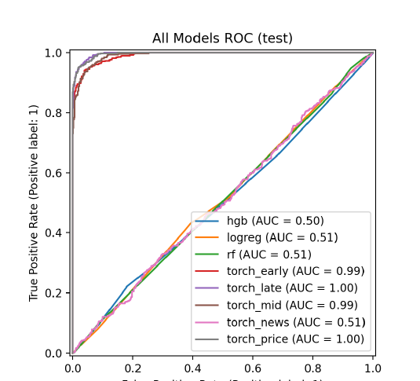
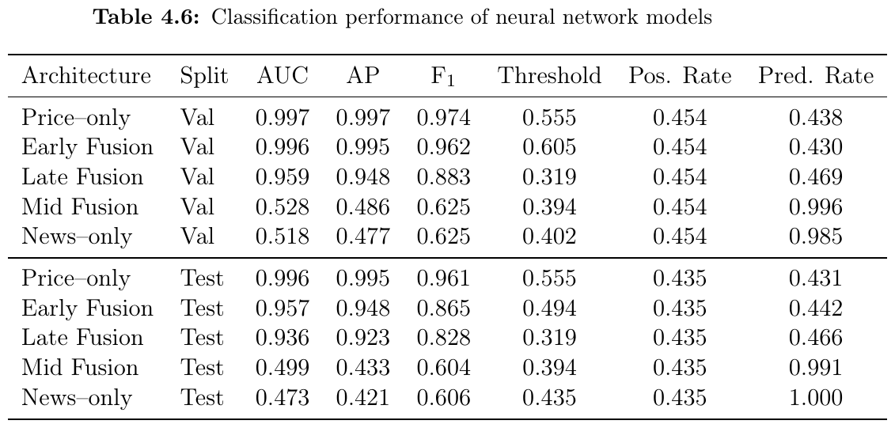
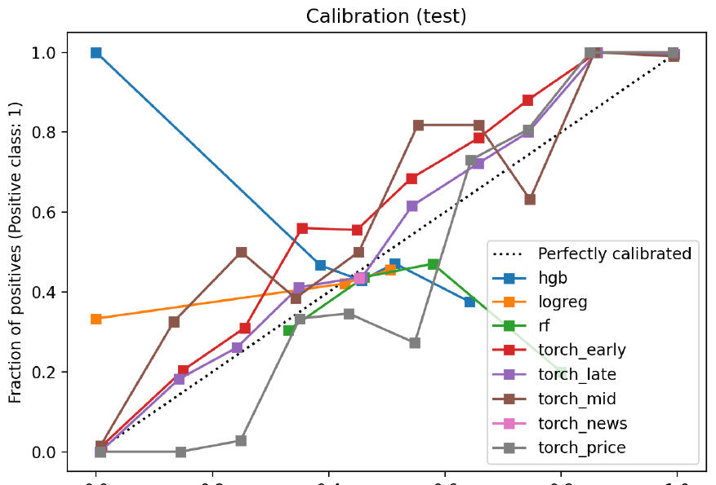

Neural Model Results (Test)
Key Finding
Price-only deep models are surprisingly dominant at a daily horizon. News provides limited incremental value under strict protocol.

Slide 19



Answer to Research Question
Main Verdict
Future Work
Price information remains the dominant signal source for daily horizons. Count-based news indicators add limited and unstable value when evaluated under strict chronological splits.
Deep models extract transferable temporal patterns from micro-dynamics that linear baselines miss completely.
Sentiment feature ablations & longer news accumulation windows.
Regime-aware modeling (explicit state shifts).
Richer finance-specific text representations .
Economic evaluation: transaction costs and strategy-level metrics.
Observation

Slide 20
Thank You!
Questions & Discussion
Yanming Jing
Università Cattolica del Sacro Cuore

